Slide 1
mobile Recharge Application
Presented by:
Shubham Pawar
Sangharsh Narwade
Kshitij Shelke
Prathamesh Margaje
Rohan Kunekar

Slide 2
Content
Introduction
Technology Used
Flow Chart
Class Diagram

Slide 3
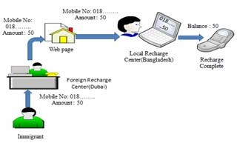
INTRODUCTION
In recent Year’s mobile phone is the easiest and suitable way for voice communication.
Integration of mobile phones with the Wireless Application Protocol (WAP) [1] and Internet enables consumers to enjoy various facilities.
Mobile Phone Users
Prepaid
Postpaid

Slide 4
Technology used
Eclipse(IDE)
Hibernate Framework
Collection Framework
Jdbc
Object Oriented Programming Language
MySQL Database
IO Stream

Slide 5
FLOW CHART
Start
Yes
Is Register
No
Enter Username
Enter Password
Enter Username
Enter Email
Enter password
Enter Mobile no
Enter Address
Enter Role
Admin
Role
User
False
Card Name
Mobile number
True
Amount
Card name
False
True

Slide 6
Cont.
A
B
Validity
Package Name
Plan added Successful
Recharge Successful
End

Slide 7
Class Diagram
Register
User
Login
+ Register
+ Login
username
email
address
mobile number
password
Id
username
email
address
mobile number
password
username
password
RechargeInfo
Enter Mobile No
Top-up
Data Pack
Unlimited Pack
Sms Pack
Airtel
Bsnl
Jio
Vodafone-Idea
Amount
Data
Talk Time
Sms
Validity
Amount
Data
Talk Time
Sms
Validity
Amount
Data
Talk Time
Sms
Validity
Amount
Data
Talk Time
Sms
Validity

Slide 8
Thank You ?

